Slide 1
IBM Capstone Project Gastronomy Tourism Application
Robu Radu Ionut
October 31 2019

Slide 2
1. Introduction: Business Problem What is Gastronomy Tourism??
Food is now a main motivation for travelers choosing their destinations. Travelers are spending more time and money on unique food and beverage experiences. We have seen a global increase in food tour companies, food and beverage focused events and food and beverage experience focused marketing efforts. But can we use machine learning to help improve the gastronomy tourism enthusiasts experience? I am a burger enthusiast, and i am interested in visiting some nice burger specific venues and also have a nice trip in some of Europe’s capitals. Can we come up with a data science approach that can help me answer my question: in witch cities can i find the best burger joints? A nice traveling location in my case should have lots of cheap and high rated burger venues and also should be as close as possible to my hometown Bucharest. By developing a data science framework to answer my question, maybe we can further help other gastronomy tourists with different interests (let’s say pizza lovers) find their next vacation location.

Slide 3
2. Methodological approach
Phase1: I will scrap 'http://techslides.com/list-of-countries-and-capitals' to get the latitude and longitude coordinates for all Europe's capital cities
Phase2: Next, I will get the venues near the capital city centers of Europe
Phase3: Extract other relevent info (likes count, photos count , price cateqory, rating etc.) using the forsquae app
Phase4: I will prepare the data for the clustering phase
Phase5: Clustering the citties using the venu info we extracte from foresquare
Phase 6: Map vizualization usnig Folium

Slide 4
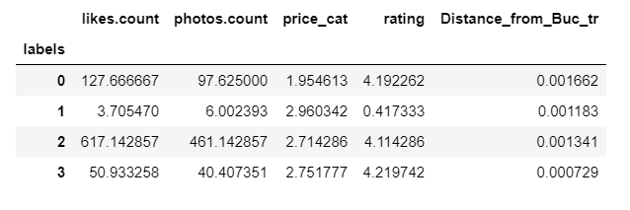
3. Results
Looking at some agregated results by cluster, it seems that the clusters with the best burger venues are "0" and "2".
So, the most atractive cities for a burger frenzy are Kiev ("UA" Ucrain in cluster "2"), Viena ("AT" Austria in cluster "0"), Sofia ("BG" Bulgaria in cluster"0"), Berlin ('DE" Germany in cluster "0") and Ankara ("TR" Turkey in cluster "0").
Well acording to wikipedia Turkey, by land mass, is positioned 95% in Asia and 5% in Europe, so maybe that is the reason that forsquare app lables Turkey as a Europe country.

Slide 5
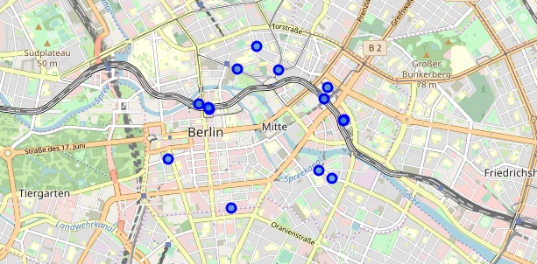
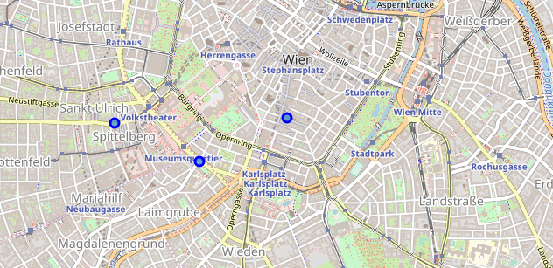
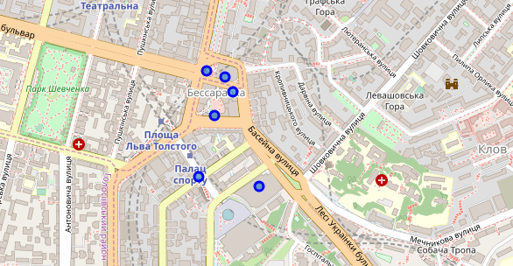
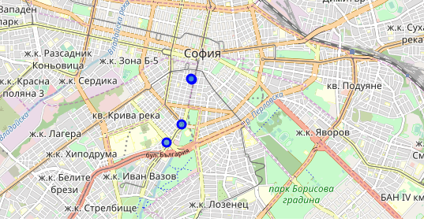
4. Visualization
Berlin: Wiena:
Kiev: Sofia:

Slide 6
5. Conclusions
By developing this data science framework to answer my question (in witch cities can i find the best burger joints? ) , I wish we can further help other gastronomy tourists with different interests (let’s say pizza lovers) find their next vacation location.
As my question goes…the answer to is clear. I found 44 venues in five cities from Europe that have interesting burgers and are now on my vacation list: Berlin, Wien, Kiev, Sofia and Ankara.

